Slide 1

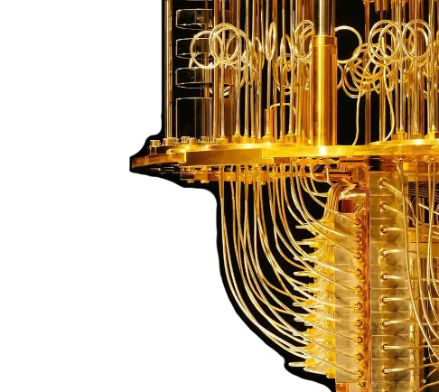
The Encryption
Endgame: Beating
the Quantum Clock
Jim West, CISSP-ISSEP, ISSAP, ISSMP, SSCP, CIPP, PMP
C-CISO, S-CISO, CEH, GSLC, GCIH, GSNA, GPEN, G2700

Slide 2
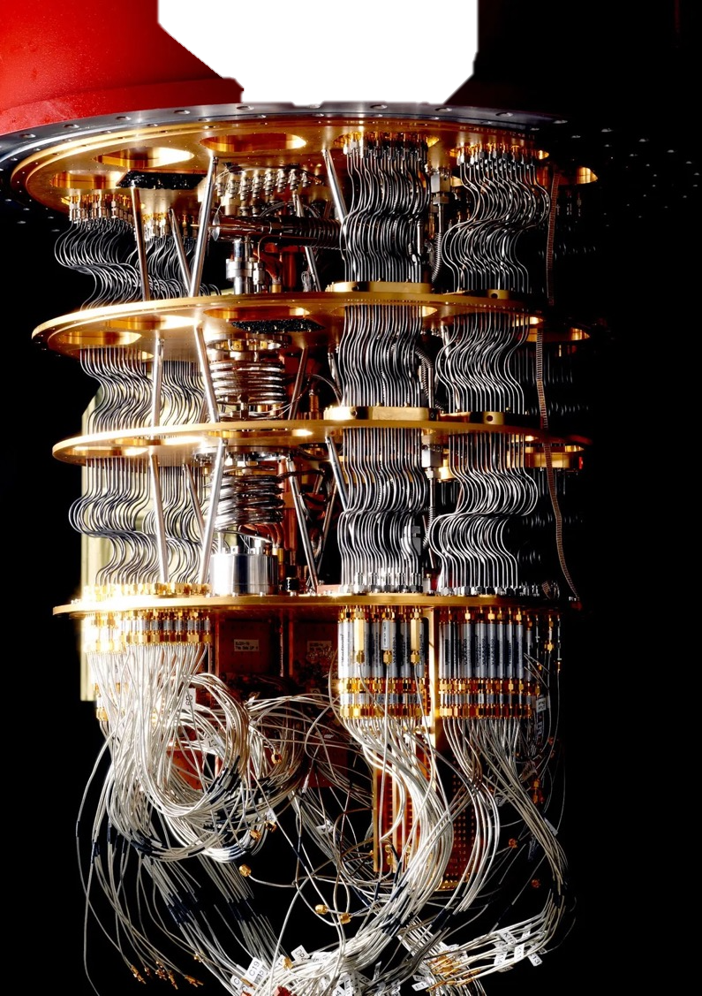

Quantum Problem
Quantum computers have emerged as a disruptive force, shattering the foundation of our current encryption standards. Traditional encryption methods, such as RSA and ECC, rely on the fact that factoring in large prime numbers or solving complex mathematical problems would take an impractical amount of time for conventional computers. However, quantum computers can perform these calculations at unprecedented speeds, rendering existing encryption algorithms vulnerable to attacks.
Quantum computers are no longer just theoretical; they are rapidly advancing and poised to disrupt encryption as we know it.
This presentation will highlight currently available encryption solutions that can significantly delay and potentially withstand attacks from quantum computers.

Slide 3

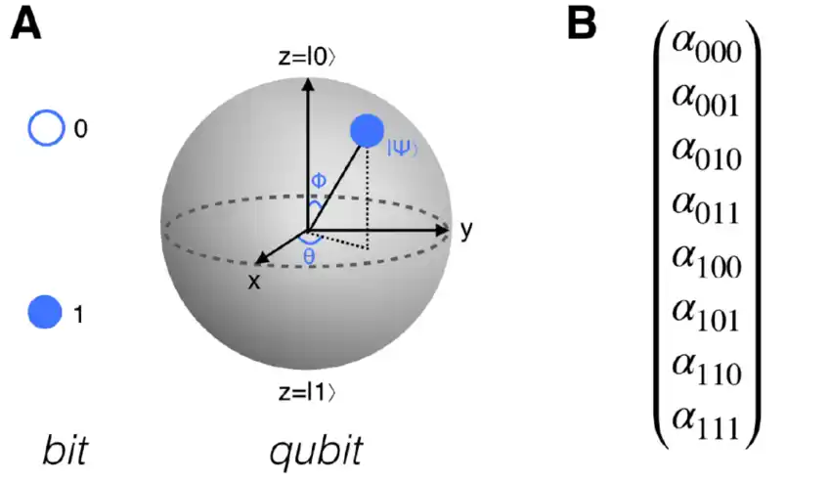
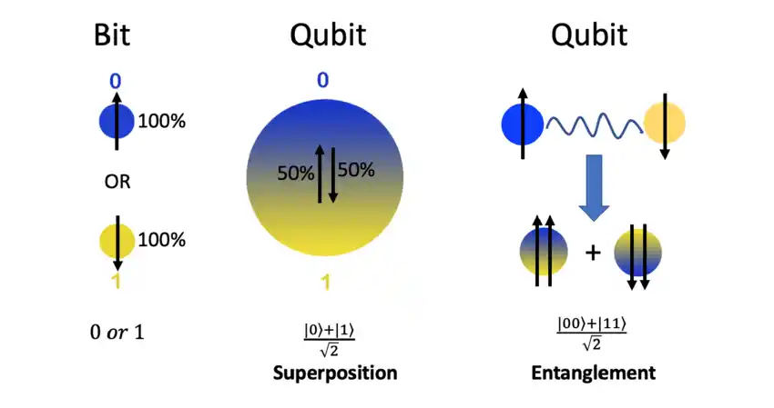
Bits to Qubits
Classic computers use ones and zeros to represent data bytes.
Qubit (Quantum Bit) is a basic unit of Quantum Information. Qubits can also achieve a mixed state, called a “superposition” where they are both 1 and 0 at the same time (imagine the lights are OFF and ON at the same time!).
A regular computer tries to solve a problem the same way you might try to escape a maze – by trying every possible path, turning back at dead ends, until you eventually find the way out. Superposition allows the quantum computer to try all the paths at once.

Slide 4

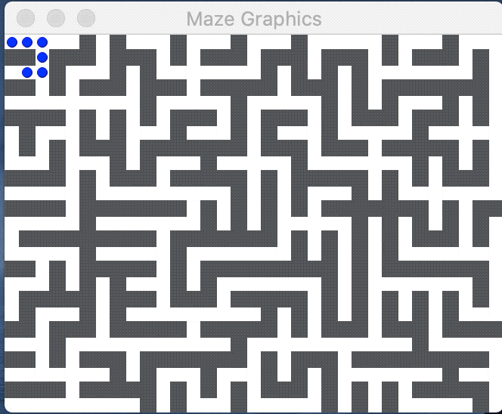
Classic Computing – One Path at a Time

Slide 5

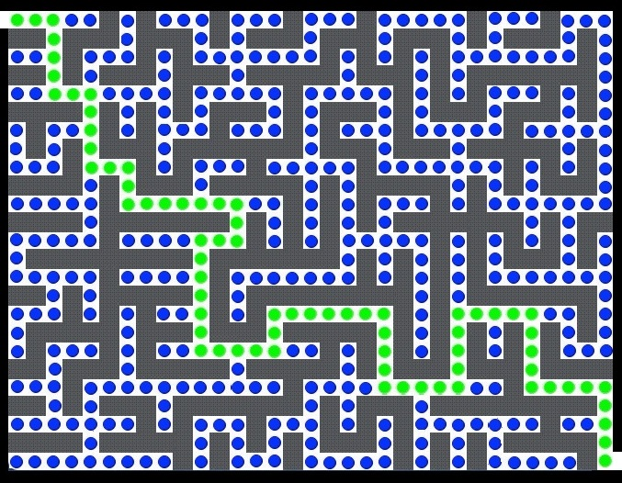
Quantum Computing – All Paths at ONCE

Slide 6

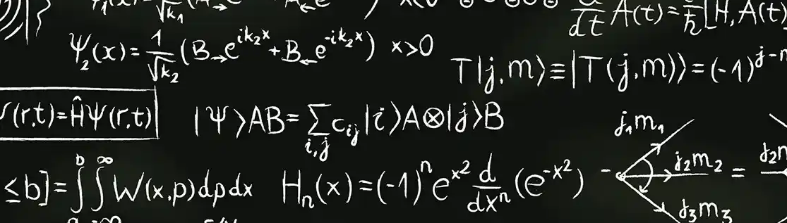
Quantum Numbers
With each qubit you add to a system, you increase the computing power exponentially (double).
Say you have four qubits give you 2⁴, which is 16 states at the same time. Jump to 64 qubits and you have 2⁶⁴, which is 18,446,744,073,709,600,000 possible states!
While 64 regular bits can also represent this huge number (2⁶⁴) of states, it can only represent one state at a time. To cycle through all these combinations, at two billion per second (which is a typical speed for a modern PC), would take about 400 years.

Slide 7



Quantum Physics
Quantum computing and quantum cryptography are at the forefront of the cyber security race to protect confidential assets.
  Currently, only Quantum Key Distribution is available:
    Uses Information Theory and Forward Secrecy to protect key exchange
    DARPA, SECOQC, SwissQuantum, Tokyo QKD NW, Los Alamos Research Lab, and a growing list of other organizations utilize this technology currently
    NSA has released open letters to industry warning of the dangers of quantum computing’s ability to defeat current crypto standards in wide use today
    RFC 2409 is the only version of the IKE standard that leverages symmetric pre-shared keys in a manner that may achieve quantum-resistant confidentiality under Commercial Solutions for Classified (CSfC)

Slide 8

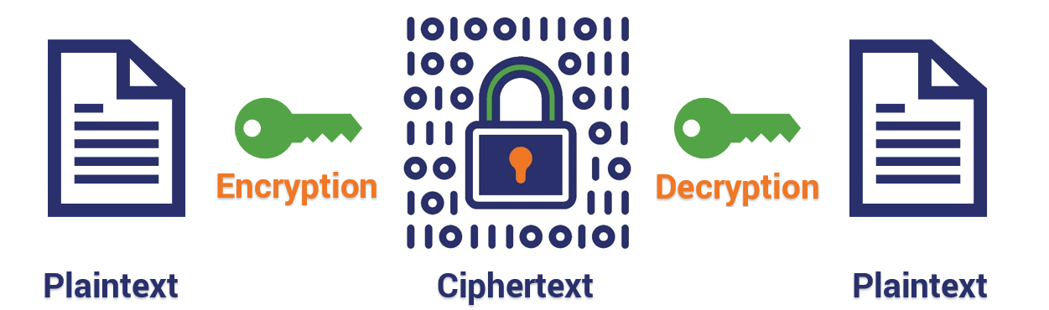
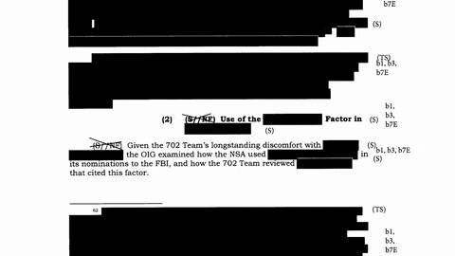
Can’t Escape the Past
Anro1571mfujm0TeLW0nfw/CERzxpQZ82jh1arWMStjxPGEJda/3E/8HX32KFjeMjzWTB/uxiWcUH06MEooeQRwnAVYIhGk2BFShWJIxtGpHpfgPwenR5dV6vrC4lBDnu/Kx6Qhh57+qnZJUgn7B3qB4Vbme0g72YiC9uurlo/E=
One day cipher-text will be readable by our partners and adversaries.
What risk to National Security will this pose?

Slide 9

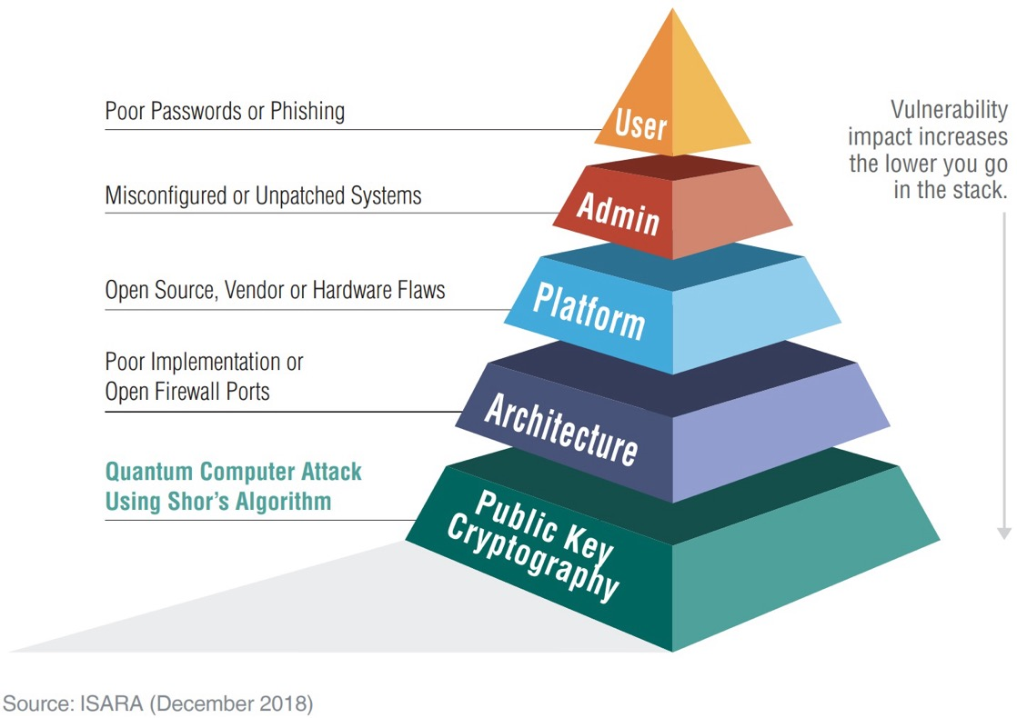
Threat Explained
According to ISARA CEO Scott Totzke, quantum technology will have a tremendous effect on organizations’ trust infrastructure. Imagine a pyramid, with cryptography at every layer – the glue holding everything together. Today’s exploits generally happen in the top layers: users, admin. With quantum computing, the most trusted elements – identity infrastructure, platform, architecture – become easier to attack.¹
¹https://www.isara.com/blog-posts/all-aboard-quantum-migration-train.html

Slide 10
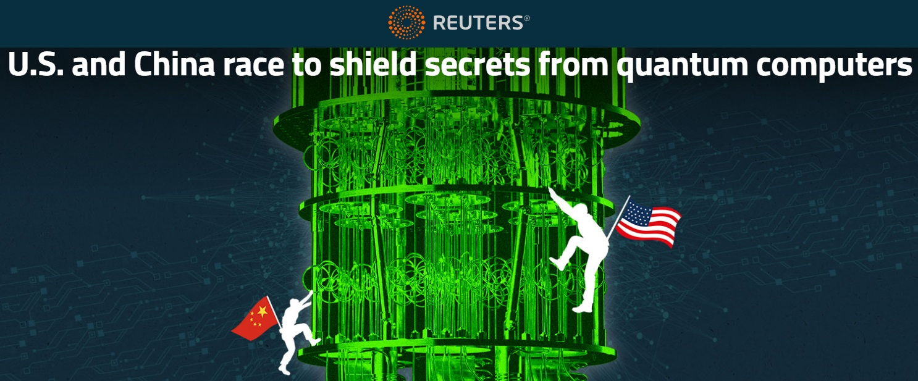
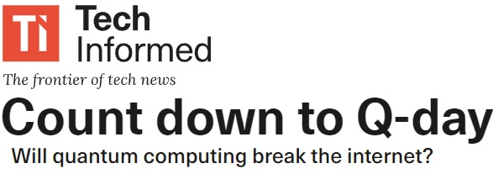
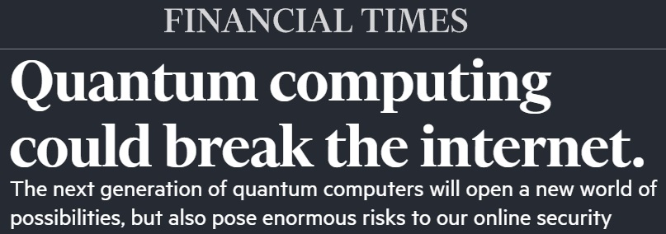
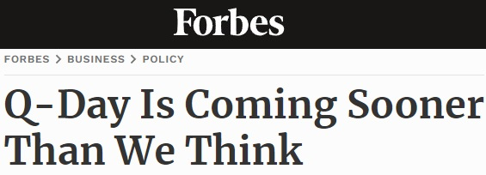
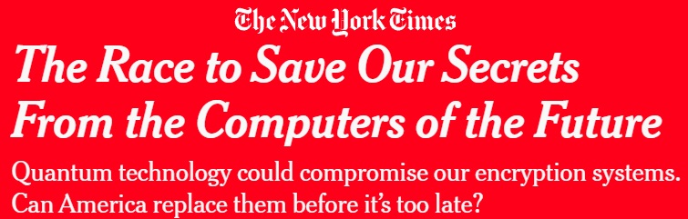
What is Q-Day?
“With a large quantum computer, China will be able to crack communications, stored data, and networks currently secured using conventional encryption techniques (RSA, DSS, Diffie-Hellman, TLS/SSL, etc.). This means financial transactions, trade secrets, protected health information, critical infrastructure networks, classified databases, satellite communications — everything — will be vulnerable.” - Michael McLaughlin, Principal Policy Advisor at Buchanan Ingersoll & Rooney PC
¹https://ig.ft.com/quantum-computing
²https://techinformed.com/count-down-to-q-day
³https://www.reuters.com/investigates/special-report/us-china-tech-quantum
⁴https://www.nytimes.com/2023/10/22/us/politics/quantum-computing-encryption.html
⁵https://www.forbes.com/sites/arthurherman/2021/06/07/q-day-is-coming-sooner-than-we-think

Slide 11

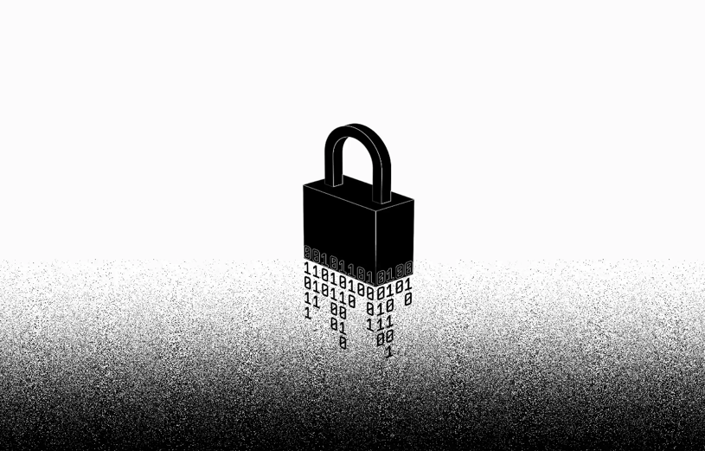
Threat to National Security
Grave danger to NSS
Diplomatic issues
Litigation
Increased tensions amongst partners
Fodder to fuel terrorism
"Anyone that wants to make sure that their data is protected for longer than 10 years should move to alternate forms of encryption now," said Arvind Krishna, director of IBM Research.
¹https://www.ibm.com/think/insights/cios-must-prepare-their-organizations-today-for-quantum-safe-cryptography

Slide 12
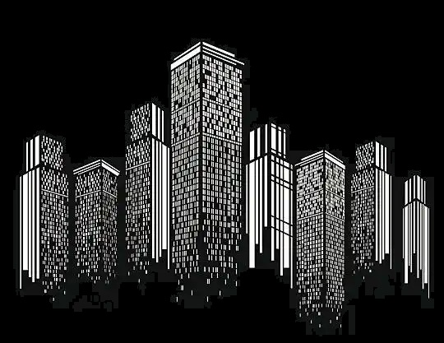
Threat to Commercial Industry
In October 2018, global research and advisory firm Gartner elevated the quantum computer threat to the top of its list of digital disruptions for which CIOs may not be prepared.¹
Corporate Espionage
Disruption to Digital Transformation efforts
Increased Targeted Attacks to IP
Render Current Safeguards Ineffective
Increased Costs to adopt Countermeasures
¹https://www.gartner.com/en/newsroom/press-releases/2018-10-17-gartner-reveals-seven-digital-disruptions-cios-may-not-see-coming
²https://s3.amazonaws.com/media.hudson.org/Executive%27s%20Guide%20to%20Quantum%20WEB%20FINAL.pdf

Slide 13

CNSA Suite 1.0
Algorithm | Function | Specification | Parameters
Advanced Encryption Standard (AES) | Symmetric block cipher used for information protection | FIPS Pub 197 | Use 256 bit keys to protect up to TOP SECRET
Elliptic Curve Diffie-Hellman (ECDH) Key Exchange | Asymmetric algorithm used for key establishment | NIST SP 800-56A | Use Curve P-384 to protect up to TOP SECRET.
Elliptic Curve Digital Signature Algorithm (ECDSA) | Asymmetric algorithm used for digital signatures | FIPS Pub 186-4 | Use Curve P-384 to protect up to TOP SECRET.
Secure Hash Algorithm (SHA) | Algorithm used for computing a condensed representation of information | FIPS Pub 180-4 | Use SHA-384 to protect up to TOP SECRET.
Diffie-Hellman (DH) Key Exchange | Asymmetric algorithm used for key establishment | IETF RFC 3526 | Minimum 3072-bit modulus to protect up to TOP SECRET
RSA | Asymmetric algorithm used for key establishment | NIST SP 800-56B rev 1 | Minimum 3072-bit modulus to protect up to TOP SECRET
RSA | Asymmetric algorithm used for digital signatures | FIPS PUB 186-4 | Minimum 3072 bit-modulus to protect up to TOP SECRET.

Slide 14

Quantum-Resistant (QR)
Unfortunately, the popular cryptographic algorithms that play a central role today in protecting proprietary information and data— including the Rivest-Shamir-Adleman algorithm (RSA), Diffie-Hellman, and digital signature algorithm (DSA)— will NOT be secure from attacks by quantum computers. Nor will blockchain, since it depends on elliptical curve cryptography (ECC), which also suffers from the same quantum vulnerability.
This leaves us with AES 256 as being deemed quantum “resistant” (QR).
To stay up to date on Quantum Cryptography:
https://csrc.nist.gov/projects/post-quantum-cryptography

Slide 15

CNSA Suite 2.0
 | Algorithm | Function | Specification | Parameters
Symmetric-key | Advanced Encryption Standard (AES) | Symmetric block cipher used for information protection | FIPS Pub 197 | Use 256 bit keys to protect up to TOP SECRET
Symmetric-key | Secure Hash Algorithm (SHA) | Algorithm used for computing a condensed representation of information | FIPS Pub 180-4 | Use SHA-384 or SHA-512 to protect up to TOP SECRET.
Software and Firmware Signing | Leighton-Micali Signature (LMS) | Asymmetric algorithm for digitally signing firmware and software | NIST SP 800-208 | All parameters approved for all classification levels. SHA-256/192 recommended.
Software and Firmware Signing | eXtended Merkle Signature Scheme (XMSS) | Asymmetric algorithm for digitally signing firmware and software | NIST SP 800-208 | All parameters approved for all classification levels.
Software and Firmware Signing | Stateless Hash-based Digital Signature(Standard SLH-DSA) SPHINCS+ | Asymmetric algorithm for digitally signing firmware and software | FIPS Pub 205 | Use Level V parameters for all classification levels.
General-use quantum-resistant public-key algorithms | Module-Lattice-Based Key-Encapsulation Mechanism Standard (ML-KEM) CRYSTALS-Kyber | Asymmetric algorithm used for key establishment | FIPS Pub 203 | Use Level V parameters for all classification levels.
General-use quantum-resistant public-key algorithms | Module-Lattice-Based Digital Signature Standard (ML-DSA) CRYSTALS-Dilithium | Asymmetric algorithm used for digital signatures | FIPS Pub 204 | Use Level V parameters for all classification levels.
Notes:
¹https://media.defense.gov/2022/Sep/07/2003071834/-1/-1/0/CSA_CNSA_2.0_ALGORITHMS_.PDF
²https://www.nsa.gov/Press-Room/News-Highlights/Article/Article/3148990/nsa-releases-future-quantum-resistant-qr-algorithm-requirements-for-national-se/

Slide 16

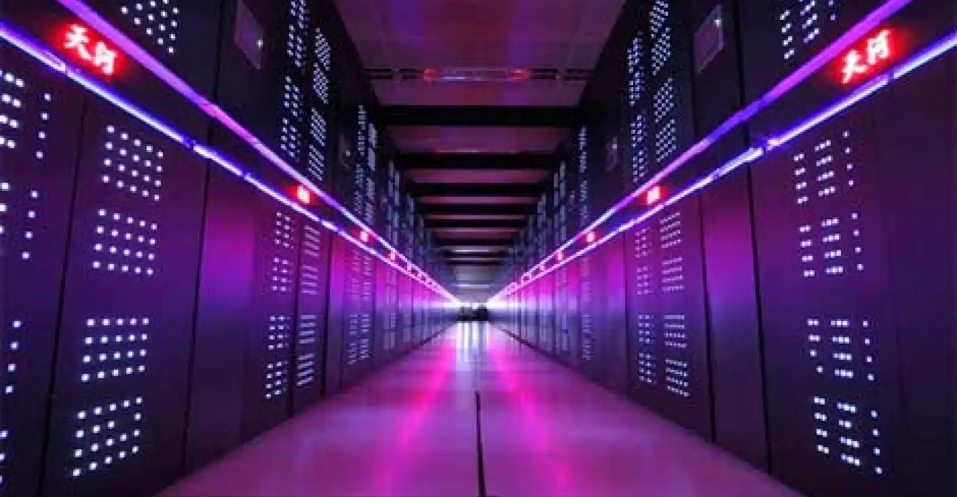
How Strong is AES 256?
A 256-bit private key will have…
115,792,089,237,316,195,423,570,985,008,687,907,853,269, 984,665,640,564,039,457,584,007,913,129,639,936
(that’s 78 digits) possible combinations. No Supercomputer on the face of this earth can crack that in any reasonable timeframe.
It would take 10³⁸ Tianhe-2A (now ranked the 24th supercomputer in the world as reported by Top500)¹ running for the entirety of the existence of everything to exhaust half of the keyspace of an AES 256 key.²
¹https://www.top500.org/lists/top500/list/2024/11/
²https://en.wikipedia.org/wiki/TOP500

Slide 17

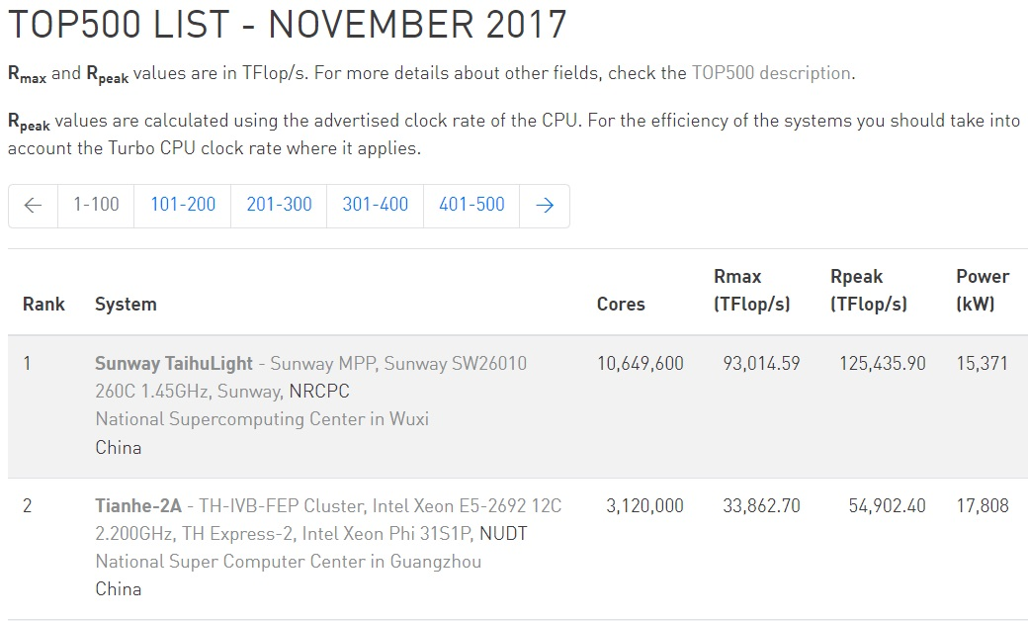
Top 500 Supercomputer List THEN
¹https://www.top500.org/lists/top500/list/2017/11/

Slide 18

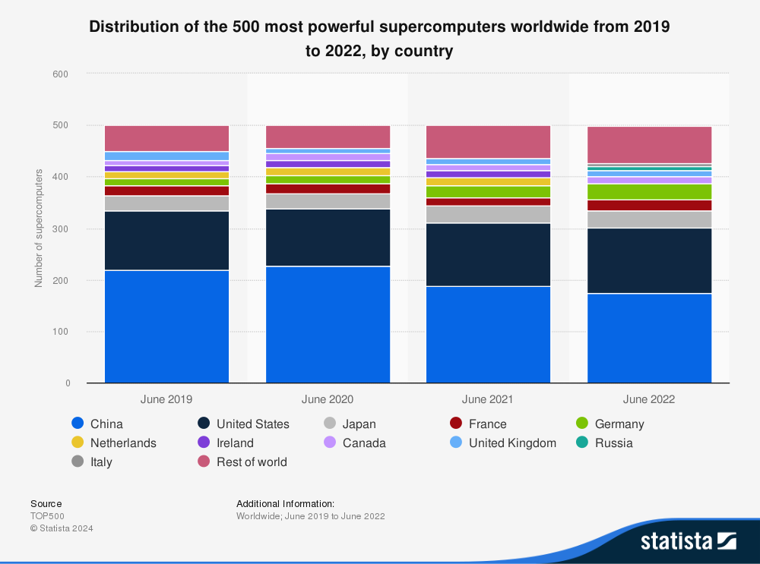
Top 500 Supercomputer by Country
"As of June 2022, 173 of the world’s 500¹ most powerful supercomputers were located in China, a figure which is a third more than that of its nearest competitor, the United States, which accounted for an additional 128 supercomputers. Together, the two nations account for around around 60 percent of the world’s most powerful supercomputers.”²
¹https://www.top500.org/lists/top500/list/2022/06/
²https://www.statista.com/statistics/264445/number-of-supercomputers-worldwide-by-country/

Slide 19

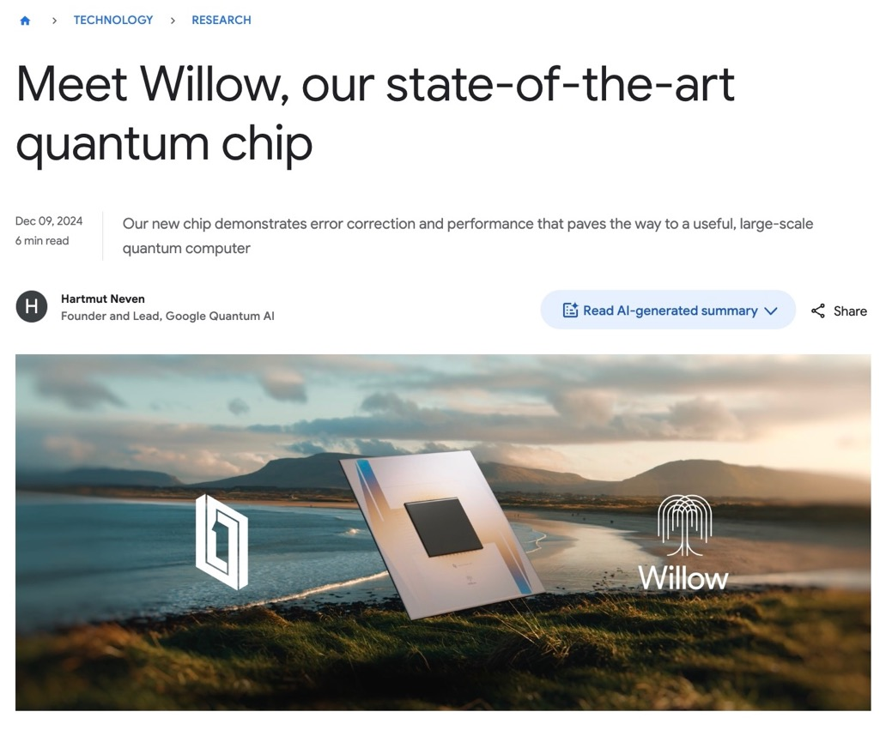
How Quantum Will Beat the Clock
“Willow performed a standard benchmark computation in under five minutes that would take one of today’s fastest supercomputers 10 septillion (that is, 10²⁵) years — a number that vastly exceeds the age of the Universe.”¹
¹https://blog.google/technology/research/google-willow-quantum-chip/

Slide 20

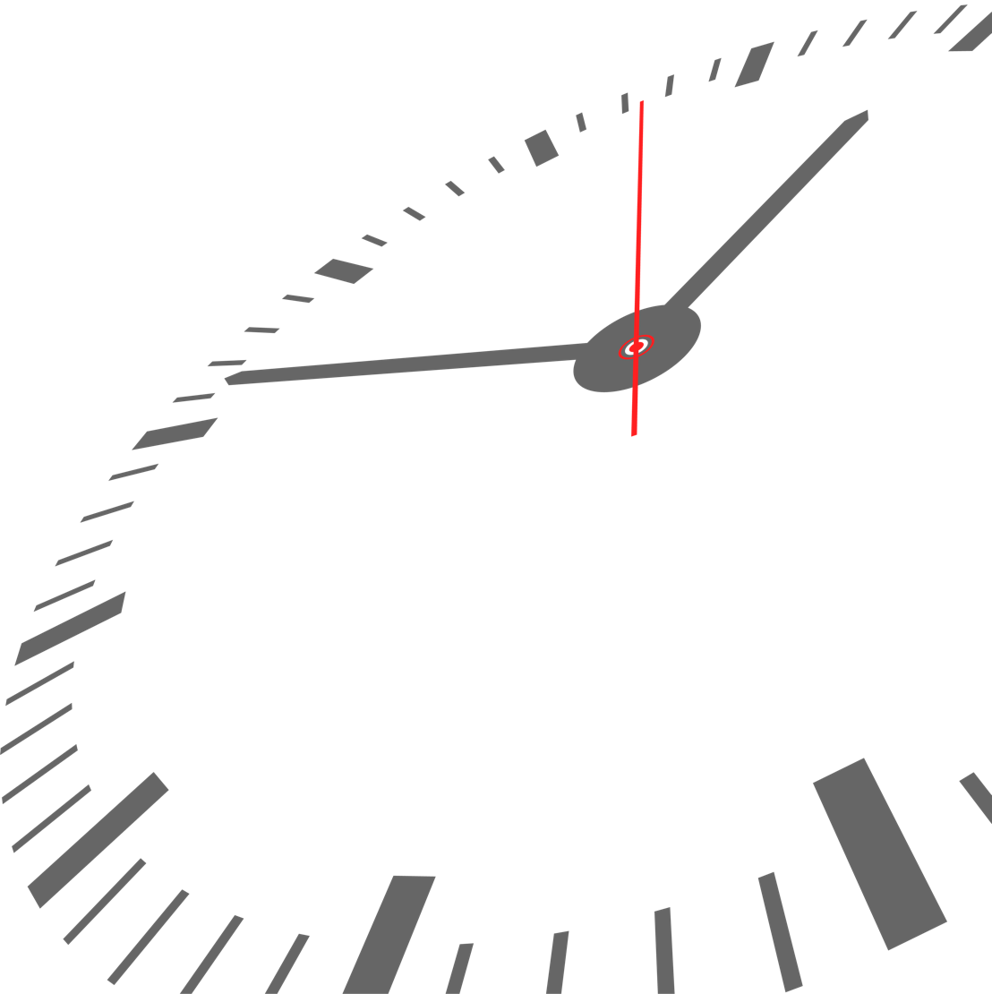
The Theoretical Math
Theoretically, to calculate the feasibility of brute-forcing half of the AES-256 key space (2²⁵⁵ keys) using a 100,000-qubit quantum supercomputer with >95% error correction and 1 billion times the computing power of Google's Willow chip, based upon publicly available information and current knowledge, let’s work through the numbers.
Final Simplified Equation:
Time (seconds)=2128(1×109×Willow_Ops300 seconds)×1Error_Correction_Overhead\text{Time (seconds)} = \frac{2^{128}}{\left(1 \times 10^9 \times \frac{\text{Willow\_Ops}}{\text{300 seconds}}\right) \times \frac{1}{\text{Error\_Correction\_Overhead}}}
Entropy – “In most operating systems, entropy is generated by collecting random events from various sources, such as hardware interrupts, mouse movements, keyboard presses, and disk activity. These events are fed into a entropy pool, which is then used to generate random numbers when needed.”¹
¹https://www.netdata.cloud/blog/understanding-entropy-the-key-to-secure-cryptography-and-randomness/

Slide 21

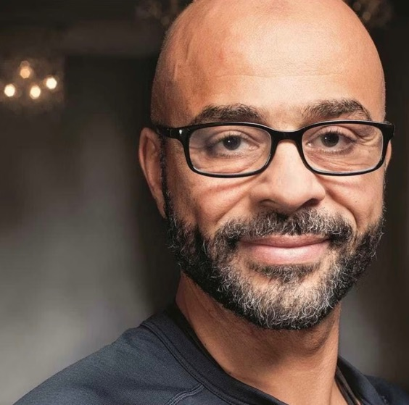
“Artificial Intelligence (AI) could reach an IQ of 1500 within the next decade.”¹ Sept. 29, 2023
The Q-Day Scenarios
- Former Chief Business Officer for Google X, “Mo” Gawdat, predicts.
Currently, the smartest man on the planet is YoungHoon Kim, with an IQ of 276, while Elon Musk has an IQ of 155, as of 2025.²
¹https://www.verdict.co.uk/ai-could-reach-an-iq-of-1500-in-the-next-10-years-mo-gawdat-tells-nbf/
²https://gigasociety.net/top-10-highest-iqs/

Slide 22

The Q-Day Scenarios
An AI with an IQ of 1000+ leveraging the power of 150+ supercomputers, which in turn are leveraging multiple grid networks of millions of bots, overwhelm and subvert multiple critical systems simultaneously, causing most systems to default secure and or shut down. Financial markets are down, and banks must freeze accounts and shut down ATMs. Civil unrest and the potential for rioting begin within 48 hours.
Nothing appears to be different. We go about our normal routines, and the markets seem fine. Life is the same, but behind the scenes, our government is being blackmailed and held hostage digitally by a nation-state that has reached quantum supremacy first. All data is vulnerable, and there is no need for exfiltration anymore, as AES 256 and AES 512 are easily defeated. There are no true quantum-proof algorithms to protect data. Yet the general population wouldn't know anything. Entire realities would be replaced with what the new "truth" is generated by AI. Destruction may not be the goal, but control by transparent manipulation…THAT becomes the new superpower.
In that scenario, we would KNOW it is happening. Yet imagine this…

Slide 23
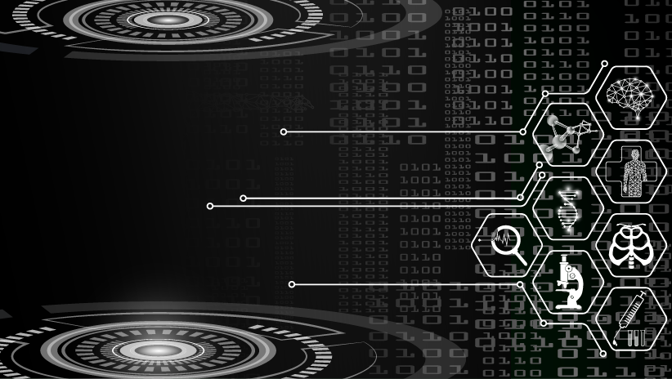
Healthcare Estimated Costs of Industry-Wide Impact:
Cost-Benefit Analysis
Total Impact of Q Day Attack: $300 billion initially, with recurring damage over time.
Preventative Costs: $560 billion upfront with reduced annual costs.
Data Breaches:
Operational Downtime:
Lost R&D:
Regulatory Fines:
Total Estimated Preventative Costs:
Average cost per record: $10 per record (current) → Potential increase post-Q Day: $100 per record.
Total affected records: ~500 million records (estimated globally).
Estimated cost: $50 billion.
Average fines per organization: $10 million.
Estimated affected organizations: 10,000.
Estimated cost: $100 billion.
Total Estimated Industry-Wide Impact: $300 billion globally.
Cost of downtime per hospital: $1 million per day.
Total hospitals affected: 50,000 globally (assumed average).
Estimated cost: $50 billion.
CSfC Solution Implementation (Healthcare Facilities): $1 million x 50,000 hospitals = $50 billion.
CSfC Solution Implementation (Pharma & Labs): $1 million x 10,000 labs = $10 billion.
Medical Device Retrofitting: $500,000 x 1 million devices = $500 billion.
Operational Training & Maintenance: $0.1 million x 60,000 = $6 billion annually.
Total Upfront Cost: $560 billion.
Annual Maintenance Cost: $6 billion.
Average loss per major pharmaceutical company: $500 million.
Number of companies: ~200.
Estimated cost: $100 billion.

Slide 24

Defense in Depth and More
Five Defense in Depth Frameworks
Uniform Protection – assured by processes conducted by NSA, NIAP, and Industry
Protected Enclaves – Gray NWs are continuously monitored and all devices utilize certs
Information Centric – secure transport of multiple NWs at different classification levels
Threat Vector Analysis –security policies and procedures can be tailored
Role Based Access Control – Strict separation of duties and auditing
Nine Security Principles
Confidentiality– the protection against the risk of unauthorized disclosure
Integrity– the protection against unauthorized modification
Availability– the protection against the risk of denial of service
Authenticity – the protection against the risk of not conforming to reality
Non-Repudiation– the protection against the risk of deniability
Authorized Use– the protection against the risk of unauthorized use of cost incurring services
Possession– the protection against the risk of loss of theft
Utility– the protection against the loss of the ability to use for the intended purpose
Privacy– the protection against the risk of disclosing personal information
https://csiac.org/webinars/beyond-the-cia-triad/

Slide 25

Beyond the CIA Triad
Confidentiality (C)
Integrity (I)
Availability (A)
Non-repudiation (NR)
Authenticity (Ac)
Authorized Use (AU)
Possession (Po)
Privacy (Pr)
Utility (U)
C
NR
Pr
I
Po
Ac
U
AU
A
https://jimwestauthor.com/beyond-the-cia-triad

Slide 26
Commercial Solutions for Classified
NSA’s Commercial Solutions for Classified (CSfC) process enables commercial products to be used in layered solutions to protect classified NSS information. This will provide the ability to securely communicate based on commercial standards in a solution that can be fielded in months, not years.
At its core is the rule of two: two completely independent layers of cryptography to protect data.
Assurances
Standards Based – NIST SP 800-53A, 800-56/57 security controls
Security Tested Capability Packages against NIAP Protection Profiles
Approved Component Selection Process via NSA
Vetted Trusted Integrator Process via NSA

Slide 27
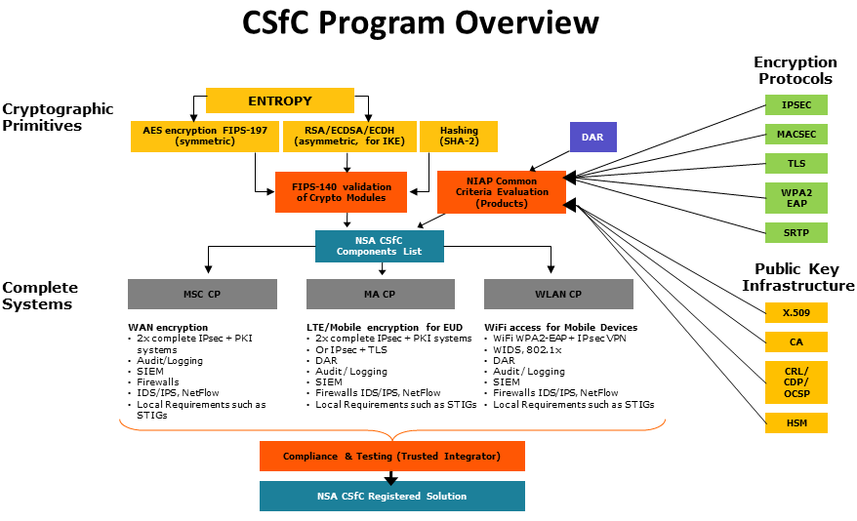

Slide 28

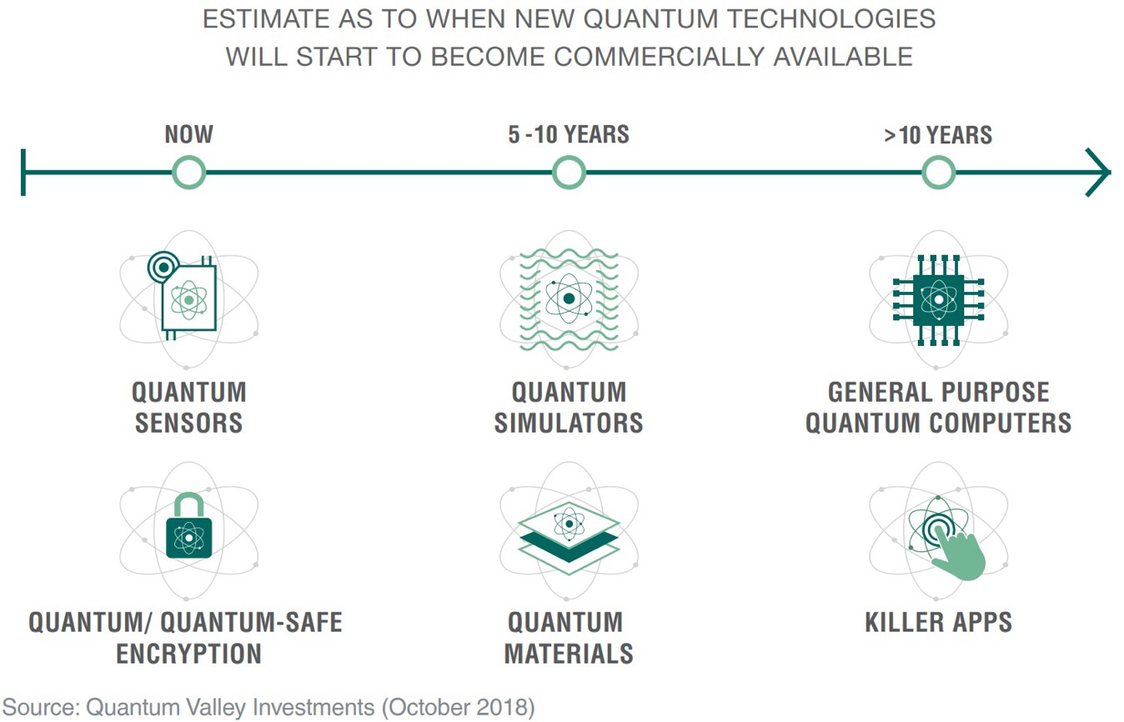
How Much Time Do We Have?

Slide 29

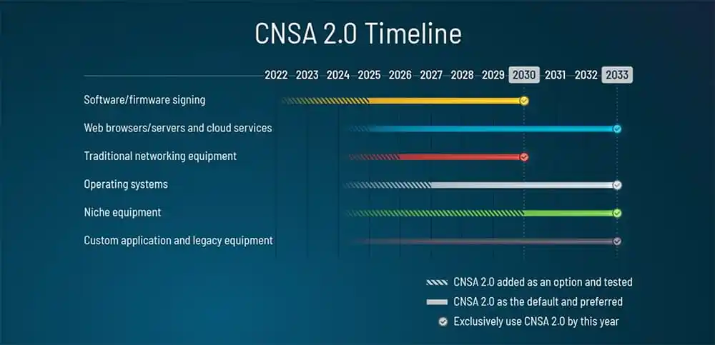
How Much Time Do We Have?

Slide 30
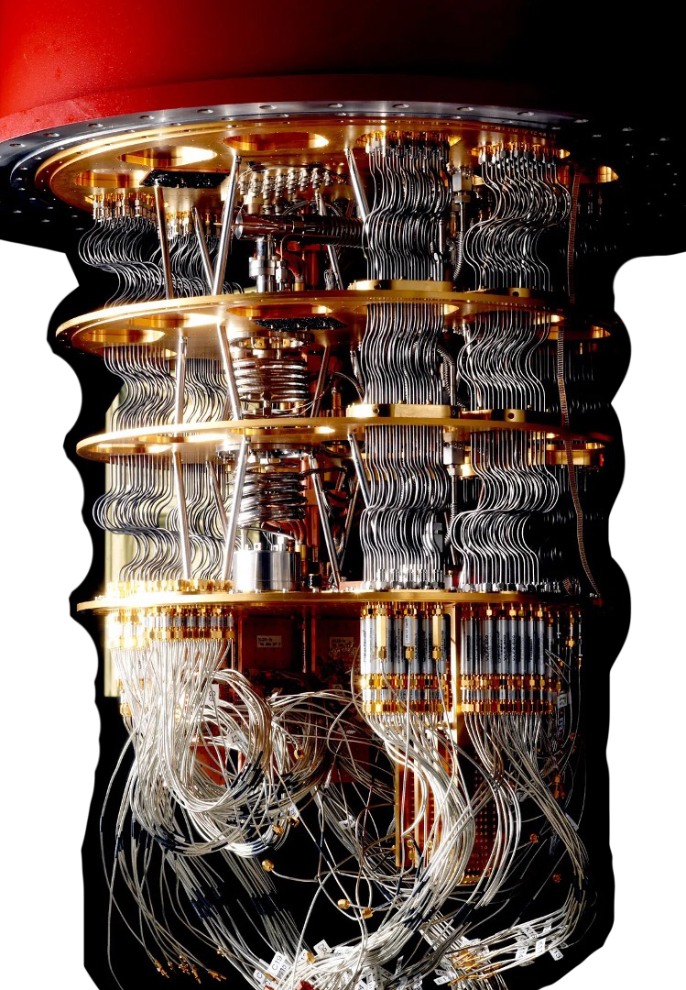

Conclusion
Conclusion
Organizations must Plan Today for the inevitable Q-Day.
Secure communications NOW, as all captured encrypted data is subject to storage and decryption later.
Consider employing layered defenses such as CSfC in security strategy.
Stay up to date with what NIST and the NSA are doing to combat this threat.
https://csrc.nist.gov/Projects/post-quantum-cryptography

Slide 31
The Encryption
Endgame: Beating
the Quantum Clock
Jim West, CISSP-ISSEP, ISSAP, ISSMP, SSCP, CIPP, PMP
C-CISO, S-CISO, CEH, GSLC, GCIH, GSNA, GPEN, G2700

